Slide 1
Identifying and Addressing Unhealthy Substance Use
Rhode Island College
School of Social Work
RI-SBIRT Resource Center
Taylor D’Addario, MA, LCDP

Slide 2
Grounding Exercise

Slide 3
RI-SBIRT Training & Resource Center
Supported by RIC SSW and BHDDH: to build statewide SBIRT awareness and capacity to
Implement and integrate SBIRT into diverse settings and organizations
Promote clinician SBIRT skills and competency
Notes:
RISBIRT works with a variety of healthcare orgs, to train and prepare sites for SBIRT implementation. including OB GYN depts., primary care sites, ED’s, CHC’s, school nurses, housing sites for elderly, etc.
The MASS Clearing house has many great pt. education materials that you can order for free. Includes the SBIRT toolkit, as well as toolkits for screening adolescents and women of child bearing age.

Slide 4
AGENDA
What is SBIRT?
Why is it important?
How is it done?
How/where is it implemented?
SBIRT & your profession

Slide 5
Introductions
Name
Where you work/intern; your position
On a 1-10 scale, how much do you know about SBIRT
What would you like to learn about SBIRT today?

Slide 6
What is SBIRT?
Screening: Identify patients with unhealthy substance use
Brief Intervention: Conversation to motivate patients who screen positive to consider healthier decisions (e.g. cutting back, quitting, or seeking further assessment).
In schools: BI for prevention for all who are screened.
Referral to Treatment: Actively link patients to resources when needed

Slide 7
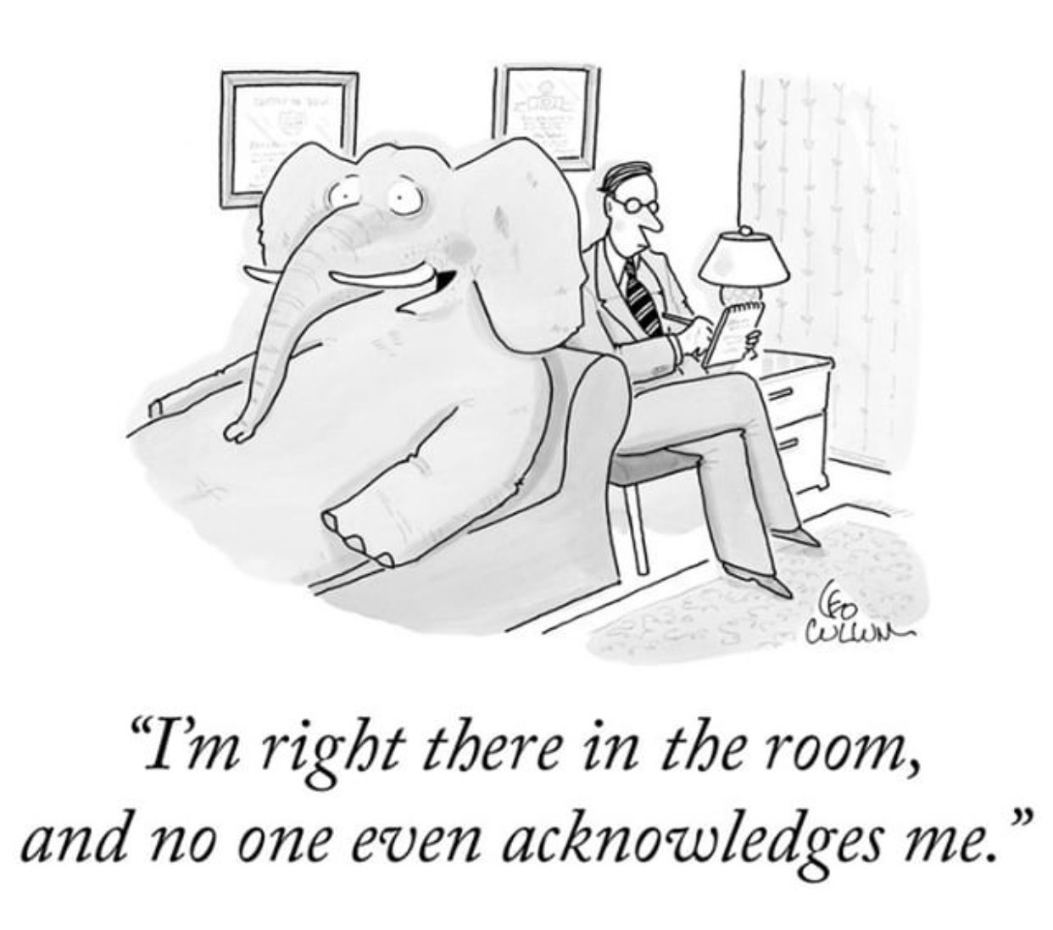
Unhealthy Substance Use in Clinical Settings
1 in 6 patients talk with their doctor, nurse or other health professional about their drinking¹
1. CDC Vital Signs. National Center for Chronic Disease Prevention and Health Promotion. January 2014.
Notes:
In a January 2014 Centers for Disease Control Vital Signs report, they cited that only 1 in 6 patients talk with a healthcare professional about their drinking. Which leaves 5 out of every 6 patients NOT talking about their drinking with a healthcare provider.
This creates an elephant in the room in which alcohol use isn’t being talked, which isn’t great.
Goal→ acknowledge the elephant in the room and create the opportunity to have a meaningful conversation about it.
SBIRT really removes the elephant by talking and asking EVERYONE about substance use, and then providing further assessment and guidance as needed.
7

Slide 8
Addiction: Historical Perspective
Problem
No Problem

Slide 9
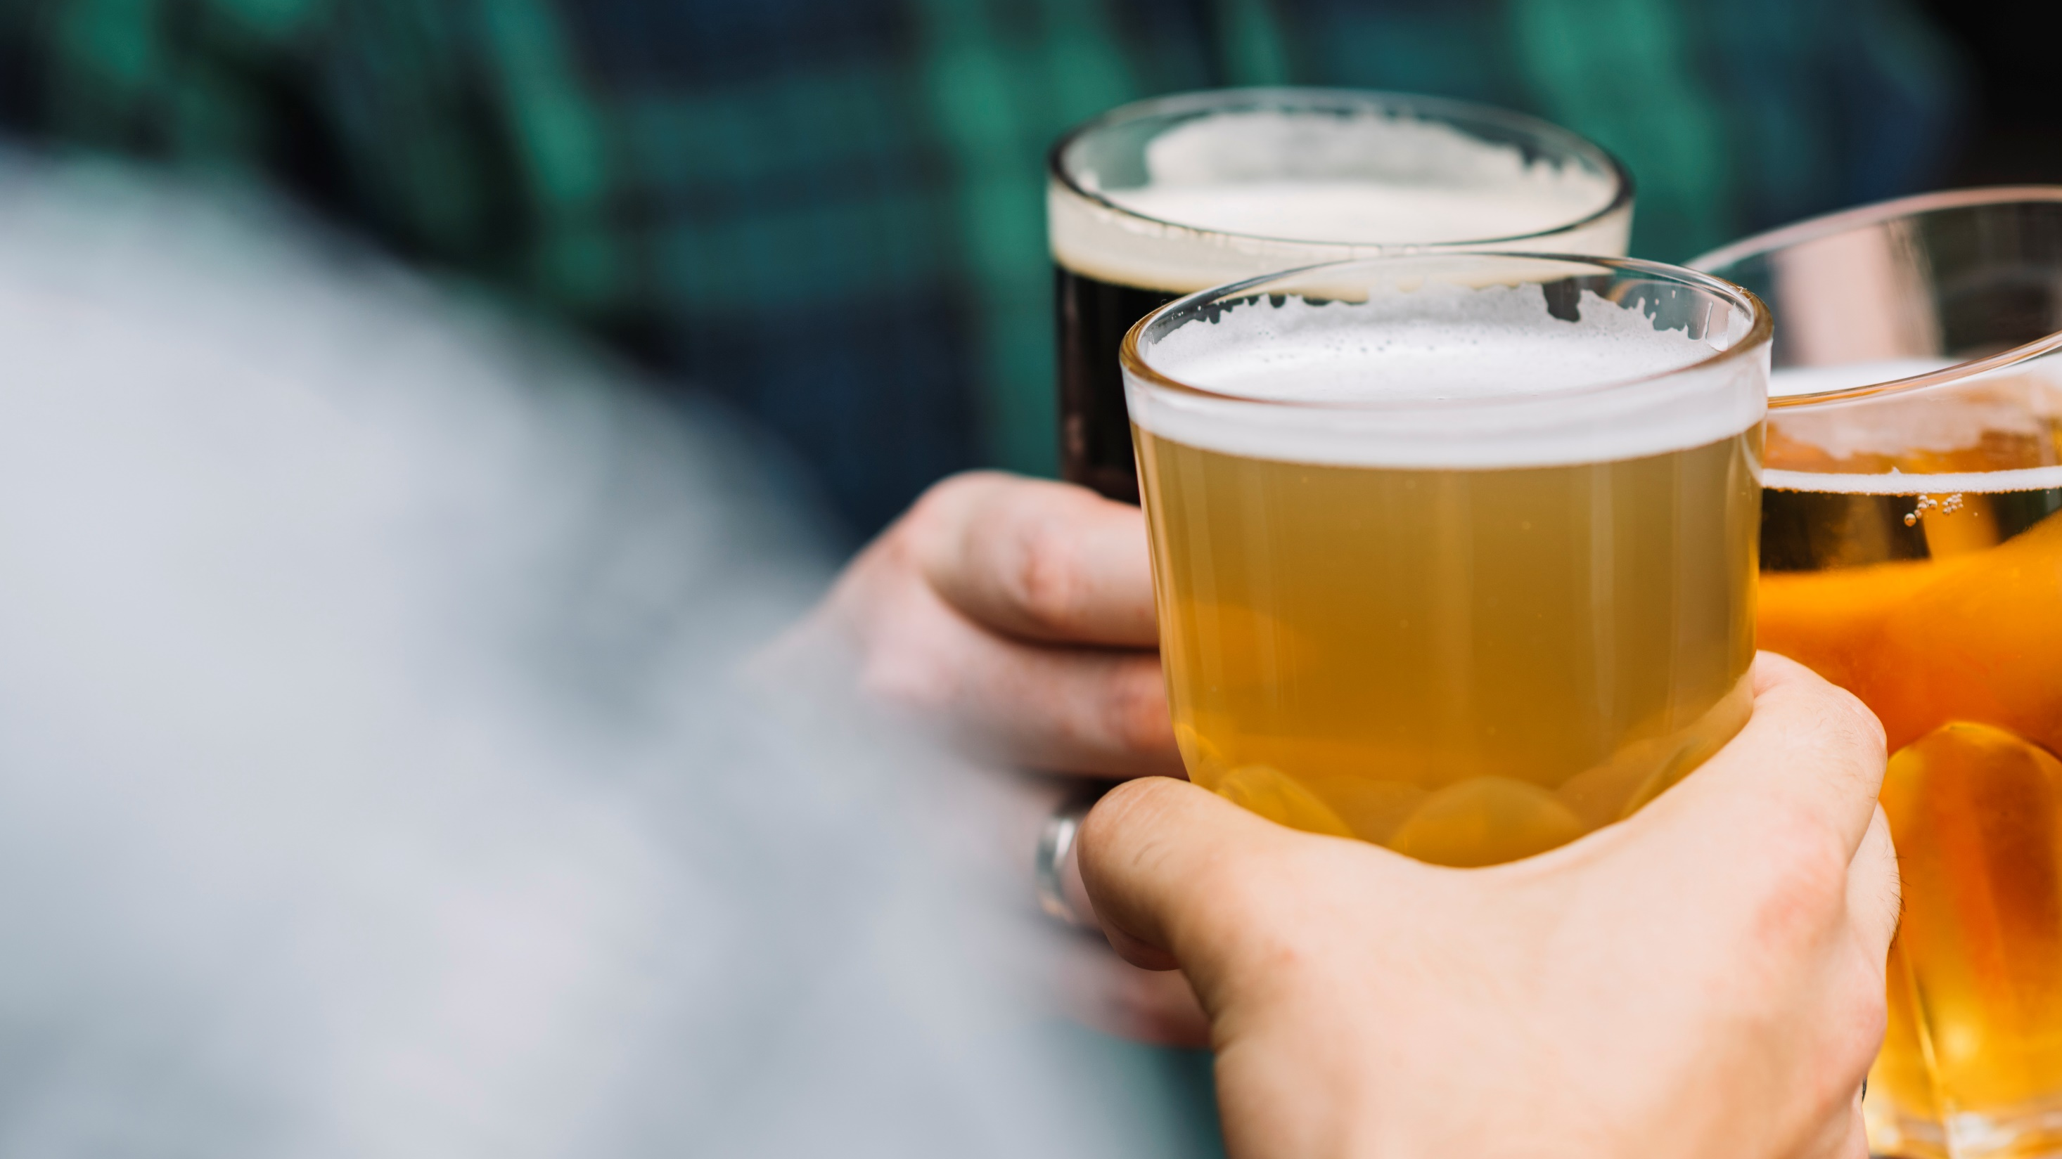
What is addiction anyway?
Short Definition of Addiction: (American Society of Addiction Medicine, 2011)
Addiction is a primary, chronic disease of brain reward, motivation, memory and related circuitry. Dysfunction in these circuits leads to characteristic biological, psychological, social and spiritual manifestations. This is reflected in an individual pathologically pursuing reward and/or relief by substance use and other behaviors.
Addiction is characterized by inability to consistently abstain, impairment in behavioral control, craving, diminished recognition of significant problems with one’s behaviors and interpersonal relationships, and a dysfunctional emotional response.
Like other chronic diseases, addiction often involves cycles of relapse and remission. Without treatment or engagement in recovery activities, addiction is progressive and can result in disability or premature death.

Slide 10
Paradigm Shift: Chronic Disease
Unhealthy
Alcohol and
Drug Use
Disease
Pre-Disease/
Higher Risk
Low / No Risk
Notes:
Alcohol binging (NIAAA)
Men (<65) more than 4 drinks/day
Women (& anyone >65) more than 3 drinks/day
Any illicit drug use
Any prescription drug misuse (taking more than prescribed or for ‘non-medical reasons’)
08/18/2020
10

Slide 11
What’s a Drink?

Slide 12
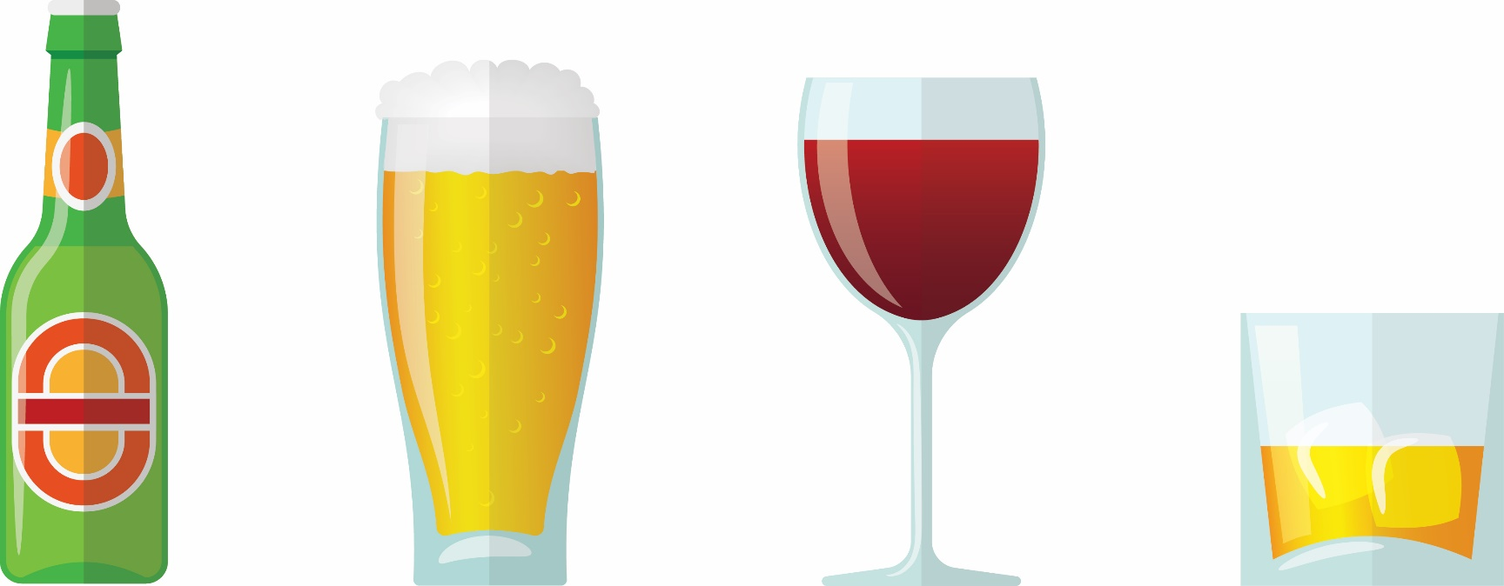
What is a “standard” drink?
12oz
8oz
5oz
1.5oz
5% alcohol beer/cooler
7% alcohol malt liquor
12% alcohol table wine
40% alcohol hard liquor
These are general measurements and your drink may be higher.
Pay attention to a drink’s alcohol percentage, not it’s size.
Refs: National Institutes of Health, NIAAA. http://rethinkingdrinking.niaaa.nih.gov/whatcountsdrink/whatsastandarddrink.asp;
Adapted from SBIRT Montana Poster: www.dphhs.mt.us
Drinking Guidelines Explained: http://ireta.org/2013/09/30/low-risk-drinking-guidelines-where-do-the-numbers-come-from/

Slide 13
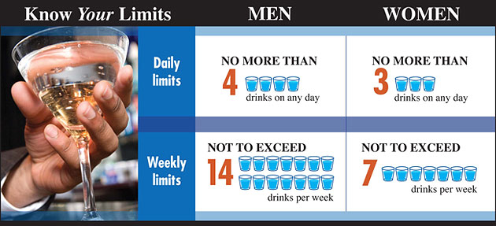
Maximum Drinking Limits For People Over 21
Non-Pregnant Women
To stay low risk, keep within BOTH the single-day AND weekly limits.
Pregnant Women are advised to abstain from alcohol use
People with medical conditions and people on medications should speak with their doctor about alcohol use.
People under 21 should not drink at all.

Slide 14
SBIRT Addresses the Full Spectrum of Substance Use
Patients may not understand the impact of alcohol and drug use on their health
Patients are not aware of NIAAA low-risk drinking guidelines
SBIRT opens up a dialogue between provider and patient that can improve the patient’s overall health
Notes:
SBIRT screens the “whole triangle” and identifies the risk.
Many times patients don’t understand the impact of alcohol and drug use on their health

Slide 15
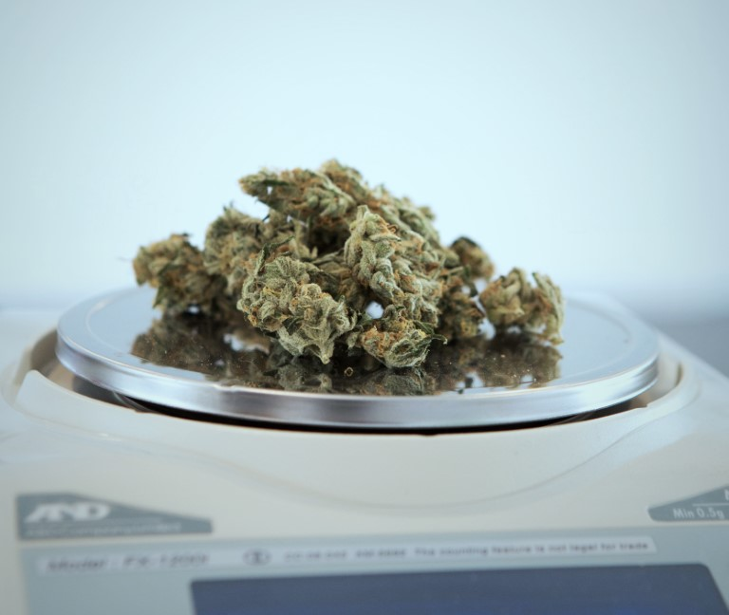
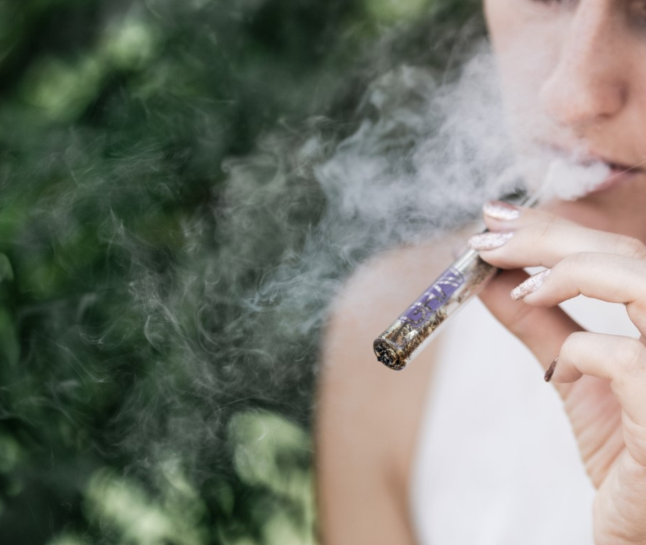
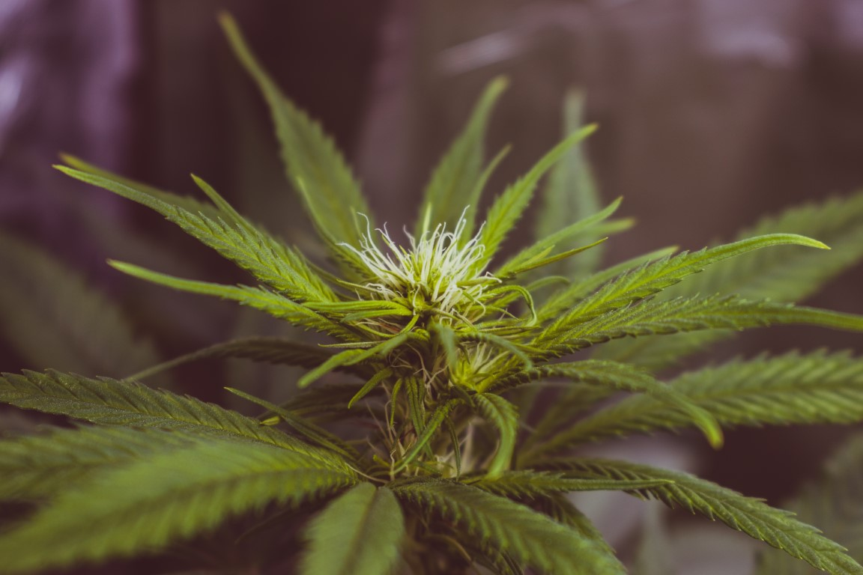
What about cannabis?

Slide 16
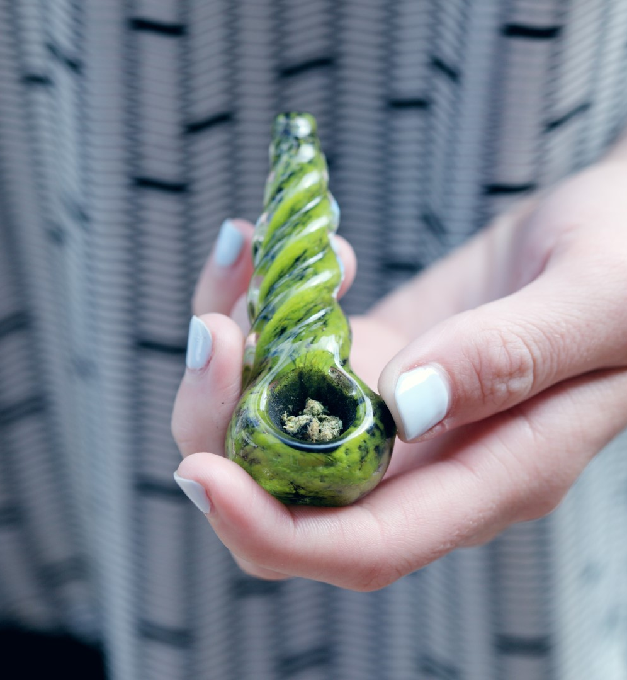
Cannabis Use
Cannabis can be addictive
According to The National Institute on Drug Abuse (NIDA) 9% of marijuana users will become addicted to it…roughly 1 in 11
That number increases to 17% for those who start using before age 16… roughly 1 in 6
Among daily marijuana 25-50 % become addicted.

Slide 17
Characteristics of Addiction- Cannabis
Compulsive marijuana-seeking behavior
A pattern of self-destructive behavior due to weed use
Failure to fulfill major life obligations at work, home or school because of pot use
Marijuana use continues in spite of recurring negative consequences, including legal consequences
Weed use continues in spite of recurring social or interpersonal problems caused by or made worse by drug use
Marijuana is used in dangerous situations
Notes:
Specify these addictive symptoms are noe substance specific- this happens with all drugs.

Slide 18
Cannabinoid System
Delta-9-tetrahydrocannabinol or THC accounts for most of marijuana's psychoactive, or mind-altering, effects.
THC is non-water soluble. THC is fat soluble. THC loves fat.
It stores in the fat cells of the body, the brain, the liver, the kidneys, in other words - the major organs
The half- life of THC for an infrequent user is 1.3 days and for frequent users 5-13 days (Smith-Kielland, Skuterud, & Morland, 1999)

Slide 19
What is the prevalence of unhealthy substance use?

Slide 20
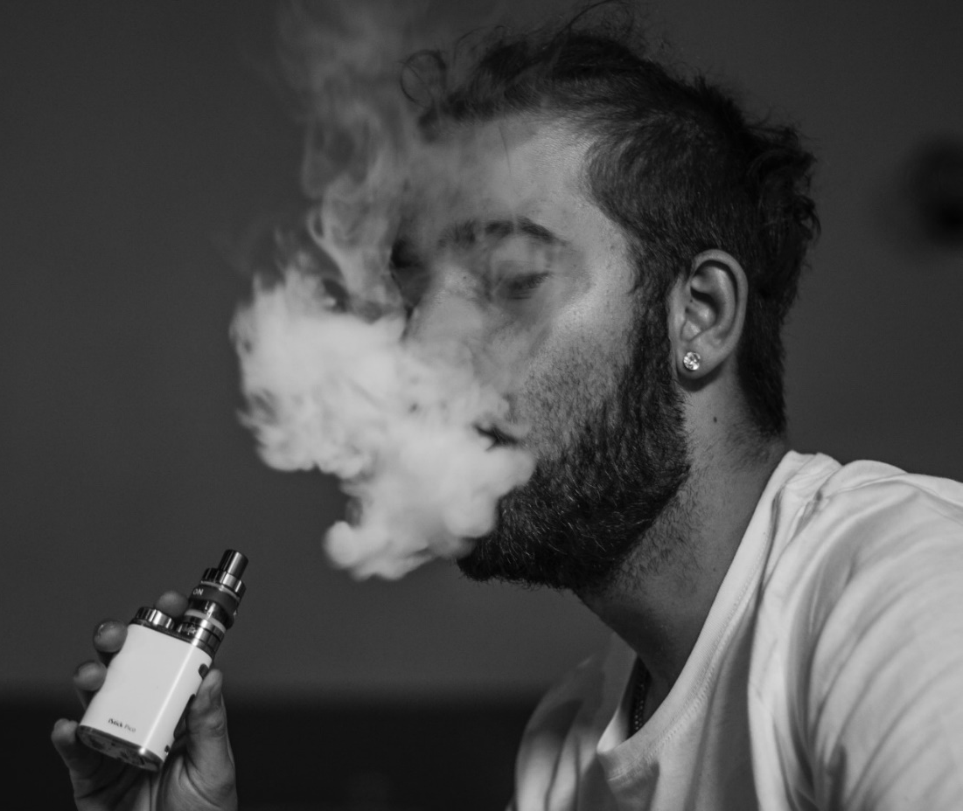
Why is SBIRT Important?
The impact of unhealthy substance use goes beyond physical health:
Social & Behavioral influences
Decreases access to preventive health care (e.g., flu vaccines in adults², mammograms in women²)
Reduces adherence with prescribed medical treatment
Adversely affects housing and employment
1. Gordon A, Alford DP. Subst Abuse 2012. 2. Lasser KE, Kim TW, Alford DP, et al. Is unhealthy substance use associated with failure to receive cancer screening and flu vaccination? A retrospective cross-sectional study. BMJ Open 2011;1:e000046.
Notes:
Could ask a question to the group--> how many of your pts have DM? HTN? SUD?
Have you talked with your pts about SUDs?
SBIRT provides an opportunity for providers to take proactive measures with patients who may be engaged in risky use of substances, but are not currently seeking or in need of specialty treatment.
Substance use can exacerbate or impact other medical conditions. Depression for example, is something for which alcohol may serve a purpose to “self-mediate” or help an individual control the symptoms that they don’t want to sit with.
Gordon AJ, Gordon JM, Carl K, Hilton MT, Striebel J, Maher M. Physical illness and drugs of abuse: A review of the evidence. Cambridge: Cambridge University Press; 2010.
(3) Brick J. Handbook of the Medical Consequences of Alcohol and Drug Abuse, Second Edition. Second ed. New York, NY: The Haworth Press; 2008.
(4) Frances RJ, Miller SI, Mack AH. Clinical Textbook of Addictive Disorders. Third ed. New York, NY: The Guilford Press; 2005.
(5) Rastegar DA, Fingerhood MI. Addiction medicine: an evidence-based handbook. Philadelphia: Lippincott Williams & Wilkins; 2005.
(6) Howard AA, Arnsten JH, Gourevitch MN. Effect of alcohol consumption on diabetes mellitus: a systematic review. Ann Intern Med. 2004;140(3):211-9.
(7) McFadden CB, Brensinger CM, Berlin JA, Townsend RR. Systematic review of the effect of daily alcohol intake on blood pressure. Am J Hypertens. 2005;18(2 Pt 1):276-86.
(8) Mehra R, Moore BA, Crothers K, Tetrault J, Fiellin DA. The association between marijuana smoking and lung cancer: a systematic review. Arch Intern Med. 2006;166(13):1359-67.
(9) Stein MD, Herman DS, Bishop S, Lassor JA, Weinstock M, Anthony J, Anderson BJ. Sleep disturbances among methadone maintained patients. J Subst Abuse Treat. 2004;26(3):175-80.
(10) Sullivan LE, Fiellin DA, O'Connor PG. The prevalence and impact of alcohol problems in major depression: a systematic review. Am J Med. 2005;118(4):330-41.
(11) Green TC, Kershaw T, Lin H, Heimer R, Goulet JL, Kraemer KL, Gordon AJ, Maisto SA, Day NL, Bryant K, Fiellin DA, Justice AC. Patterns of drug use and abuse among aging adults with and without HIV: A latent class analysis of a US Veteran cohort. Drug Alcohol Depend. 2010.
(12) Gordon AJ, Haas GL, Luther JF, Hilton MT, Goldstein G. Personal, Medical, and Healthcare Utilization Among Homeless Veterans Served by Metropolitan and Nonmetropolitan Veteran Facilities. Psychol Serv. 2010;7(2):65-74.
(13) Gordon AJ, Montlack ML, Freyder P, Johnson D, Bui T, Williams J. The allegheny initiative for mental health integration for the homeless: integrating heterogeneous health services for homeless persons. Am J Public Health. 2007;97(3):401-5.
B1]Lasser KE, Kim TW, Alford DP, Evans S, Cabral H, Saitz R, Samet JH. Is unhealthy substance use associated with failure to receive preventive services? BMJ Open. 2011 doi:10.1136/bmjopen-2010-000046: 1-8
From Lasser et al:
Women with unhealthy substance use are less likely to receive mammograms than women without unhealthy substance use.
Persons with unhealthy substance use are less likely to receive flu vaccination than persons without unhealthy substance use.
Unhealthy substance use is not a risk factor for not receiving cervical or colorectal cancer screening.

Slide 21
Why is SBIRT important?
Impact of Behavioral Health Comorbidities on Per Capita Costs among Medicaid-Only Beneficiaries with Disabilities
Boyd C, Leff B, Weiss C, Wolff J, Hamblin A, Martin L. Data Brief: Clarifying Multimorbidity Patterns to Improve Targeting and Delivery of Clinical Services for Medicaid Populations, Center for Health Care Strategies, Inc. December 2010
Notes:
-Per capita= average income per person
This demonstrates the average per person spending cost among a given population, Medicaid-only beneficiaries that have disabilities.
Among these individuals, a variety of health conditions were exampled to see how mental health, SUDs and the co-occurrence of both of them on the average per person spending.
The BLUE bars show individuals with no mental illness or SUDs
The RED bar shows MH and no drug or alcohol
The GREEN bar shows no MH, but yes to drug and alcohol
The PURPLE bars show co-occurrence of both MH and SUDs.
In examining a variety of medical conditions, costs increase with SUDs, and further increase with SUDs/MH conditions.
High cost and targeting interventions to decreases cost … s

Slide 22
Co-occurring Disorders
Of individuals with a MH disorder:
1/3 will experience unhealthy substance use at some point¹
Of those with severe mental illness:
50% will develop a substance use disorder ²⁻⁵
Of women with unhealthy substance use:
As many as 2/3 of women may have a MH disorder ⁶
Adapted from: IHR Co-Occurrence of MH with Physical & Sexual Abuse Fact Sheet.
Sacks S et al. Substance Use & Misuse 1997. 2. Drake RE et al. Psych Rehab Jour 2004. 3. Barry KL et al. Schizophrenia Bull 1995. 4. Kessler RC et al. Arch Gen Psych 1997. 5. Mueser KT et al. Acta Psychiatrica Scandinavica 1992. 6. Alexander, M.J. American Journal of Orthopsychiatry 1996.
Notes:
MH disorders and unhealthy substance use go hand and hand
Some other research shows that:
Of individuals who have a MH disorder, 1/3 of them also experience unhealthy substance use at some point.
Relatively speaking that’s 2X the rate of individuals that experience unhealthy substance use in comparison with individuals without a MH diagnosis.

Slide 23
Trauma and Addiction
Prevalence of PTSD and Substance Use Disorders
Among persons who develop PTSD, 52% of men and 28% of women are estimated to develop an alcohol use disorder.
35% of men and 27% of women develop a drug use disorder.(Najavits, 2007)
The numbers are even higher for veterans, prisoners, victims of domestic violence, first responders, etc. (Najavits, 2004a, 2004b, 2007)
Individuals with PTSD are 3 to 4 times more likely to develop SUD’s than individuals without PTSD have earlier histories with A & D, more severe use, and poor treatment adherence. (Khantzian & Albanese, 2008)

Slide 24
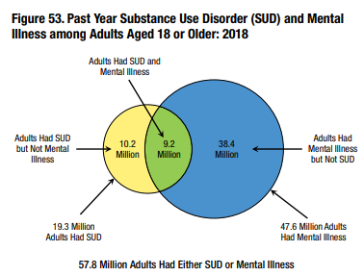
Substance Use and Mental Illness in US Adults
Nearly 1 in 12
US Adults had a Substance Use Disorder in the past year
19.3 MILLION
Nearly 1 in 5
US Adults had any mental illness
in the past year
47.9 MILLION
9.2 MILLION
Co-Occurring
Ref: SAMHSA. www.SAMHSA.gov
Substance Abuse and Mental Health Services Administration,
Center for Behavioral Health Statistics and Quality.
The CBHSQ Report: Substance Use and Mental Health Estimates
from the 2018 National Survey on Drug Use and Health:
Overview of Findings. Rockville, MD.
Notes:
We’ve talked a little bit about the prevalence of unhealthy substance use, now let’s get a picture of the prevalence of unhealthy substance use and MH disorders in the US.
This data if from The Center for Behavioral Health Statistics and Quality (CBHSQ) in the Substance Abuse and Mental Health Services Administration(SAMHSA) which works to collects, analyzes, and disseminates critical public health data.
This information is from a 2013 report.
There are 7.7 million Americans living with SUD and MH disorders. This is a little more than 3% of all adults.
How does this information translate to your practice?

Slide 25
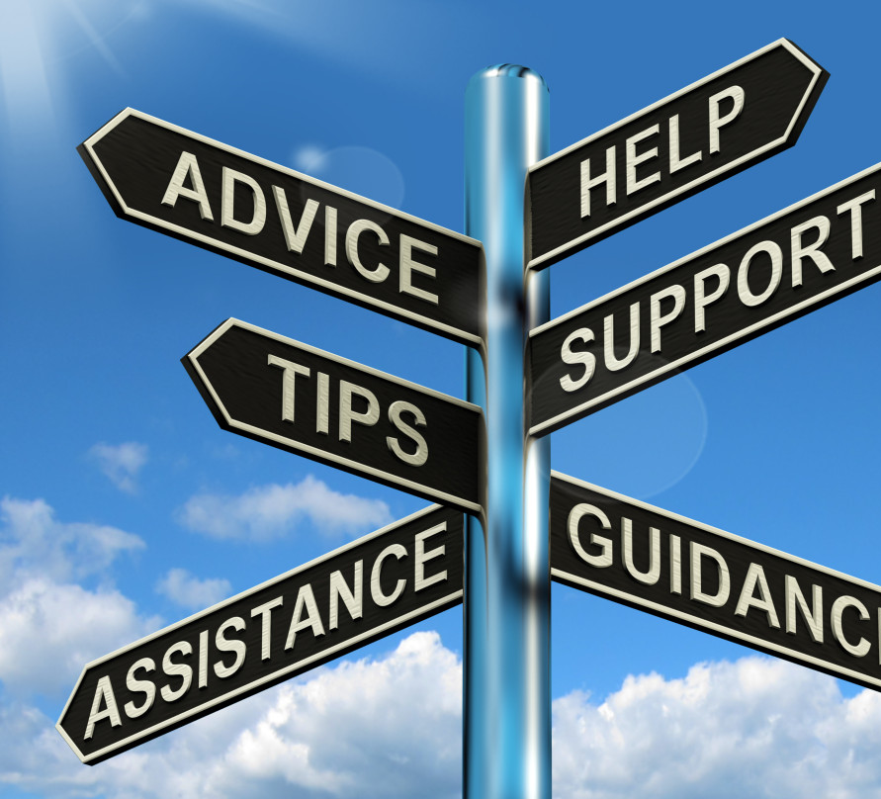
SBIRT Effectiveness
SBIRT has been found to be most effective:
With lower severity alcohol use identified in primary care
May increase the percentage of patients who enter specialized care and decrease hospital days
Ongoing research to determine effectiveness of SBIRT for drug use, other settings, severities, and adolescents
Kaner, E Drug Alc Review 2009
Krupski, A Drug Alc Dep 2010
Saitz, JAMA 2014
Hingson R, JAMA 2014
Saitz, R Ann Intern Med 2007
Estee, S Medical Care 2010
Roy-Byrne, JAMA 2014
Bogenschutz, JAMA Int Med 2014
Notes:
There has been over 40 years of research on SBIRT and it’s been found to work best in the primary care setting among individuals with lower severity (risky) drinking. In these patients, SBIRT has been effective in reduce alcohol use (such as reduce weekly alcohol consumption by 13-34%), reduce binge drinking episodes and improve adherence to recommended limits.
SBIRT also may increase the percentage of patients who enter specialized care and decrease the days they are in the hospital.
Ongoing research is understand how SBIRT works for drug use and other severities & settings (adolescents) is ongoing.
Recently there has been some randomized controlled trials (gold standard for research) that have demonstrated SBIRT was not effective to decrease drug use in a primary care setting, but research is ongoing to understand that.

Slide 26
SBIRT Goals
Addiction:
Treat and/or refer for specialty addiction treatment
Risky Use:
Educate to decrease risk of negative health & safety consequences and progression of disease
Low/No Risk:
Educate about risks and reinforce/ promote healthy norms
Notes:
The goals of SBIRT are to screen everyone and provide appropriate feedback whenever someone is falling on the spectrum.
One of SBIRT’s main focuses is to identify low/no risk individuals and continue to provide education about the risks associated with alcohol or other behaviors. Additionally, promoting the health norms and affirming the choices these individuals are making.
Risky use is another opportunity for SBIRT to provide education about alcohol or other substances, including negative health and safety consequences, in an effort to prevent the progression of the disease.
Individuals with addiction (substance use disorders) may need treatment or specialty treatment.
26

Slide 27
Why is SBIRT important?

Slide 28
Generalizability of SBIRT Concepts
SBIRT
Identify unhealthy behaviors
The language of SBIRT is key
Nonjudgmental
Open-ended
Goal-oriented
Behaviors extend beyond SUDs including:
Medication compliance
Diet & exercise
Behavioral Health
Trauma
Holistic picture of healthy behaviors
Notes:
SBIRT is unique, informed and generalizable.
It’s main goal is to identify unhealthy behaviors, which can extend beyond SU.
It provides a language to discuss risks and work with patients,
The language of SBIRT is key!
Lee and I will talk about this more, but this is the critical tool.
It provides you, the clinician, with non-judgmental, open-ended and goal oriented ways to talk with your patients.
These behaviors extend beyond SUDs including med compliance, diet & exercise, self-care, trauma, behavioral health, and working to provide the pt with a holistic picture of healthy behaviors.

Slide 29
Health Consequences of Substance Use
Cancer
Breast
Throat
Mouth
Esophagus
Liver
Accidents/Injury
Pancreatitis
HIV/AIDS
Osteoporosis
Renal disease
Fetal Alcohol Spectrum Disorders
Cardiovascular disease
Stroke
Cardiomyopathy
Arryrithmias
Hypertension
Diabetes Mellitus
Hepatitis C
Overdose
Depression
Liver disease
Fibrosis
Cirrhosis
Alcoholic hepatitis
Source: UpToDate 2015 Mukamal KJ. Overview of the risks and benefits of alcohol consumption .
Up To Date 2015. Weaver MF, Jarvis MAE. Substance use disorder: Principles for recognition and assessment in general medical care.
http://pubs.niaaa.nih.gov/publications/Hangovers/beyondHangovers.pdf
Notes:
Depending on a patient’s use/severity/ family hx/previous medical history, etc. SU can lead to a variety of health consequences from hypertension to overdose, etc.
SBIRT provides an opportunity for providers to take proactive measures with patients who may be engaged in risky use of substances, but are not currently seeking or in need of specialty treatment.
Substance use can exacerbate or impact other medical conditions. Depression for example, is something for which alcohol may serve a purpose to “self-mediate” or help an individual control the symptoms that they don’t want to sit with.
From Lasser et al:
Women with unhealthy substance use are less likely to receive mammograms than women without unhealthy substance use.
Persons with unhealthy substance use are less likely to receive flu vaccination than persons without unhealthy substance use.
Unhealthy substance use is not a risk factor for not receiving cervical or colorectal cancer screening.

Slide 30
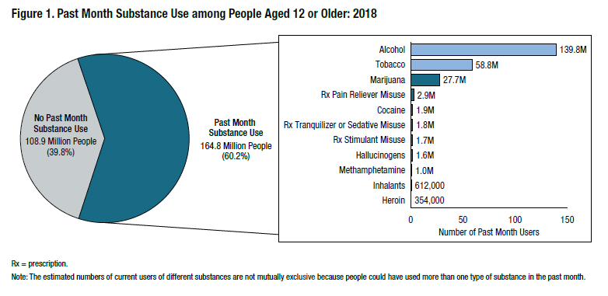
Key Substance Use and Mental Health Indicators in the United States: Results from the 2018 National Survey on Drug Use and Health
Notes:
In 2018, an estimated 164.8 million people aged 12 or older used a substance (i.e., tobacco, alcohol, or an illicit drug) in the past month (Figure 1). This number of current substance users corresponds to 60.2 percent of the population. About 2 out of 5 people aged 12 or older (108.9 million, or 39.8 percent) did not use substances in the past month. The 164.8 million current substance users in 2018 include 139.8 million people who drank alcohol, 58.8 million people who used a tobacco product, and 31.9 million people who used an illicit drug (2018 DT 7.3). These numbers are not mutually exclusive because respondents could have used more than one type of substance (e.g., tobacco products and alcohol) in the past month.
Although about half of the people aged 12 or older (51.1 percent) drank alcohol in the past month and 1 in 5 (21.5 percent) used a tobacco product, use of illicit drugs was less common (Table A.1B). About 1 in 9 people aged 12 or older (11.7 percent) used an illicit drug in the past month.

Slide 31
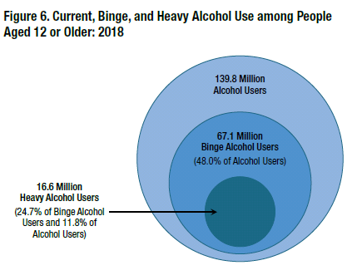
Lower Risk
At Risk
At Risk
Key Substance Use and Mental Health Indicators in the United States: Results from the 2018 National Survey on Drug Use and Health
Notes:
Binge drinking involves taking in a specific amount of alcohol during a short timespan. According to the National Institute on Alcohol Abuse and Alcoholism (NIAAA), men who take in five drinks in about two hours are binge drinking, as are women who take in four drinks in about two hours
Figure 6. Current, Binge, and Heavy Alcohol Use among People
Aged 18 to 25
In 2018, an estimated 55.1 percent of young adults aged 18 to 25 were current alcohol users (Figure 7), which corresponds to about 18.8 million young adults. The percentage of young adults in 2018 who drank alcohol in the past month was lower than the percentages in 2002 through 2016, but it was similar to the percentage in 2017. In addition, more than half of young adults were current alcohol users in each year from 2002 to 2018 (ranging from 55.1 to 62.0 percent).

Slide 32
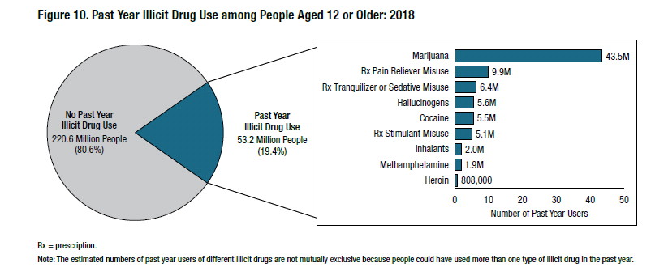
Key Substance Use and Mental Health Indicators in the United States: Results from the 2018 National Survey on Drug Use and Health

Slide 33
Introducing Screening
to Patients
Screening is universal
Contributes to quality healthcare
Confidential as part of your medical / school record
Ask permission to screen: Think MI (Motivational Interviewing)!

Slide 34
Screening Adults: Alcohol
Single Item Alcohol Question
Assess
- AUDIT
- ASSIST
- AUDIT C
- S MAST- G
- CAGE /AID
Screen

Slide 35
NIAAA Single-Item Alcohol Question
Do you sometimes drink beer, wine, or other alcoholic beverages?
NO
YES
If one or more times, continue with assessment , i.e. AUDIT, CAGE-AID, ASSIST
How many times in the past year have you had 5 (men)/4 (women or men over 65) or more drinks in a day?
Sensitivity/Specificity: 82%/79% (unhealthy use)
Smith PC, Schmidt SM, Allensworth-Davies D, Saitz R. Primary care validation of a single-question alcohol screening test. J Gen Intern Med 2009; 24(7):783-8
Notes:
Often times the pre-screen and the screener is done as part of another survey – like a wellness questionnaire.
The slide has changed so it was not inconsistent in that it reports sens. and spec for drug DISORDER which includes abuse dependence. But sens spec for unhealthy alcohol which includes use plus disorder (risky use actually. What should appear in the slides for drug is 92.9 and whatever the spec for use is. Drug use is the equivalents of unhealthy alcohol. (rich)
-Sensitivity= If a person has a disease, how often will the test be positive (true positive rate)? Put another way, if the test is highly sensitive and the test result is negative you can be nearly certain that they don’t have disease.
-Specificity= If a person does not have the disease how often will the test be negative (true negative rate)?In other terms, if the test result for a highly specific test is positive you can be nearly certain that they actually have the disease.

Slide 36
Audit
RESPONSES:
(0) Never, (1) Less than monthly, (2) Monthly (3) Weekly, (4) Daily or almost daily
1. How often do you have a drink containing alcohol?
2. How many drinks containing alcohol do you have on a typical day when you are drinking?
(0) 1 or 2 (1) 3 or 4 (2) 5 or 6 (3) 7 to 9 (4) 10 or more
3. How often do you have five or more drinks on one occasion?
How often during the last year have you…
4. found that you were not able to stop drinking once you had started?
5. failed to do what was normally expected from you because of drinking?
6. needed a first drink in the morning to get yourself going after a heavy drinking session?
7. had a feeling of guilt or remorse after drinking?
8. been unable to remember what happened the night before because you had been drinking?
9. Have you or someone else been injured as a result of your drinking?
(0) No (2) Yes, but not in the last year (4) Yes, during the last year
10. Has a relative or friend or a doctor or another health worker been concerned about your drinking or suggested you cut down?
(0) No (2) Yes, but not in the last year (4) Yes, during the last year
The AUDIT was developed by the World Health Organization

Slide 37
AUDIT Translating Scores into Practice
Positive AUDIT score | Risk Level | Recommendation
7-15 (♀) 8-15 (♂) | At Risk | Brief Intervention (simple advice)
16-19 | Harmful Use | Brief Intervention & Extended Intervention(s) or Brief Treatment
20-40 | Likely Dependence | Referral to specialist for assessment and treatment
© Partners in Integrated Care
Notes:
Lee
This diagram provides an illustration of how to match between level of risk and type of intervention. However, clinical judgment should always be used and can override these recommended protocols.

Slide 38
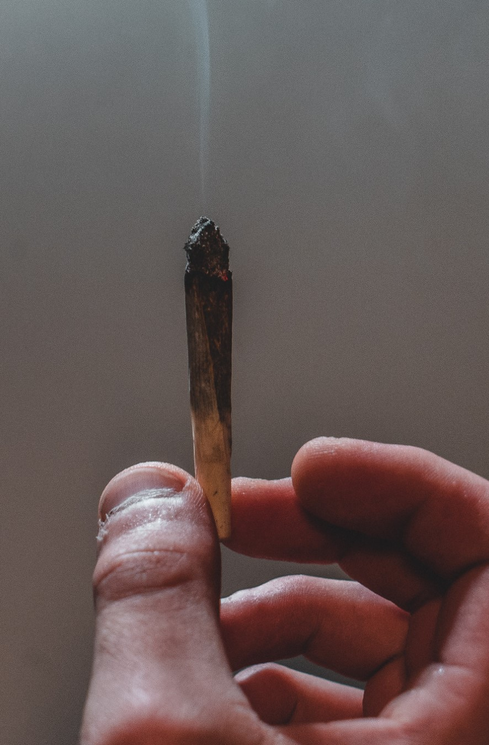
Screening Adults: Drugs
Single Item Drug Question
Assess
- DAST 10
- ASSIST
- CAGE /AID
Screen

Slide 39
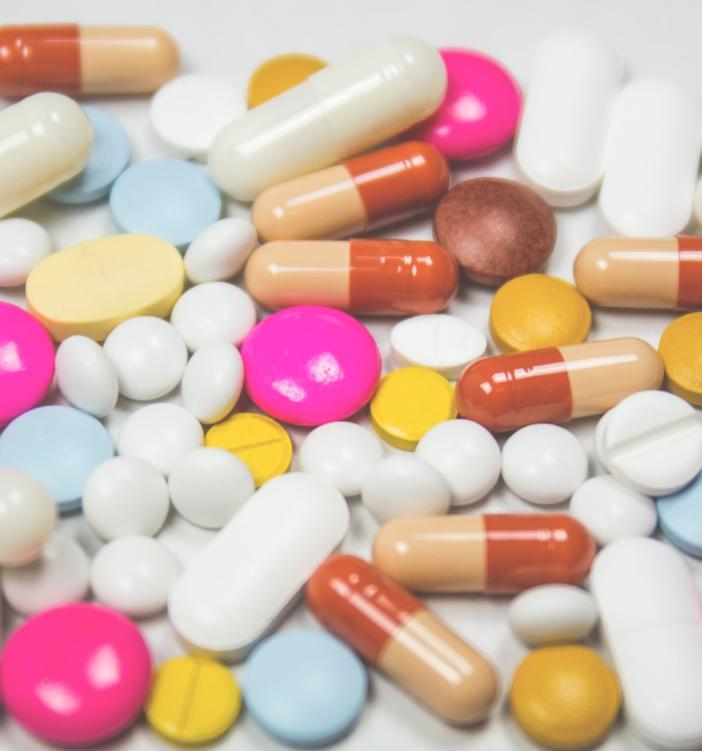
Single Item Drug Question
How many times in the past year have you used an illegal drug or used a prescription medication for non-medical reasons?*
(*because of the experience or feeling that the drug(s) caused)
None
Score of ≥ 1 : continue with assessment,
i.e. CAGE-AID, DAST 10
Sensitivity/Specificity: 100%/74%
Smith P.C., Schmidt S.M., Allensworth-Davies D, Saitz R. A single-question screening test for drug use in primary care. Arch Intern Med 2010; 170(13):1155-60.
Notes:
Often times the pre-screen and the screener is done as part of another survey – like a wellness questionnaire.

Slide 40
DAST-10
1. Have you used drugs other than those required for medical reasons?
2. Do you abuse more than one drug at a time?
3. Are you unable to stop using drugs when you want to?
4. Have you ever had blackouts or flashbacks as a result of drug use?
5. Do you ever feel bad or guilty about your drug use?
6. Does your spouse (or parents) ever complain about your involvement with drugs?
7. Have you neglected your family because of your use of drugs?
8. Have you engaged in illegal activities in order to obtain drugs?
9. Have you ever experienced withdrawal symptoms (felt sick) when you stopped taking drugs?
10. Have you had medical problems as a result of your drug use (e.g., memory loss, hepatitis, convulsions, bleeding)?
DAST © Copyright 1982 by Harvey A. Skinner, PhD, and the Centre for Addiction and Mental Health, Toronto, Canada
Notes:
Lee

Slide 41
DAST-10 Translating Scores into Practice
Add 1 point for each “yes”
Positive DAST score | Degree of Problems Related to Drug Abuse | Recommendation
2 | Low | Brief Intervention
3-5 | Moderate | Brief Intervention & Extended Intervention
6-8 | Substantial | Brief Intervention, Extended Intervention, and Referral
9-10 | Severe | Referral to specialist for assessment and possible treatment
Notes:
Lee

Slide 42
Why SBIRT For Youth?
Reduces substance use related harm during adolescence
Provides education and intervention for both primary and secondary prevention to keep all patients healthy
Provides early identification of risky behaviors to assist providers with treatment planning
Identifies need for referral to prevent harm at the earliest possible stages among patients

Slide 43
Prevalence of Lifetime DX of SUD by Age of Onset of Drinking: It’s Bad To Start Drinking Early
©2007 Center for Adolescent
Substance Abuse Research,
Children’s Hospital Boston. All rights reserved.
Source: Hingson et al., 2006
<13 14 15 16 17 18 19 20 21+
Notes:
This study conducted by Hingson and colleagues surveyed over 43,000 adults (from a national survey, NESARC). Of those adults, they used diagnosistic criteria to categorize who met criteria for alcohol dependence (based on DSM-IV criteria).
Of those adults who met criteria for alcohol dependence, they completed a retrospective analysis to see at what age they began drinking. “Respondents were asked the age at which they first started drinking, not counting tastes or sips, which was categorized as younger than 14 years, separately for each year from 14 through 20 years old, and 21 years and older (the minimum legal drinking age in the United States.
They found a strong relationship with the age in which the individual began drinking and the percentage of lifetime dependence.
47% of individuals who began drinking at age 13 or younger had a diagnosis of alcohol dependence at adulthood.
Only 9% of individuals who began drinking at age 21 or older developed alcohol dependence.
Researchers concluded that:
Nearly half (46%)of drinkers who developed alcohol dependence began drinking at 16 years or younger, although only one quarter of drinkers started by that age.
First, the younger the age at which people started to drink, the greater their likelihood of developing alcohol dependence within 10 years of drinking onset and before age 25 years.
One risk that we think about particularly in regard to adolescents is brain development. We are continuing to understand how the brain matures and developed, and we now know that brain development continues on until early adulthood (mid-20s). Lots of brain connections are continuing to develop and solidify during adolescence and substance use (i.e., marijuana use) may interrupt important parts of brain development.

Slide 44
Teens and Substance Use;
Some Good News
Most students go through school & don’t ever use drugs or get drunk.
The Monitoring the Future (MTF) survey found that:
53.3% never used any illegal drug
58% never smoked marijuana.

Slide 45
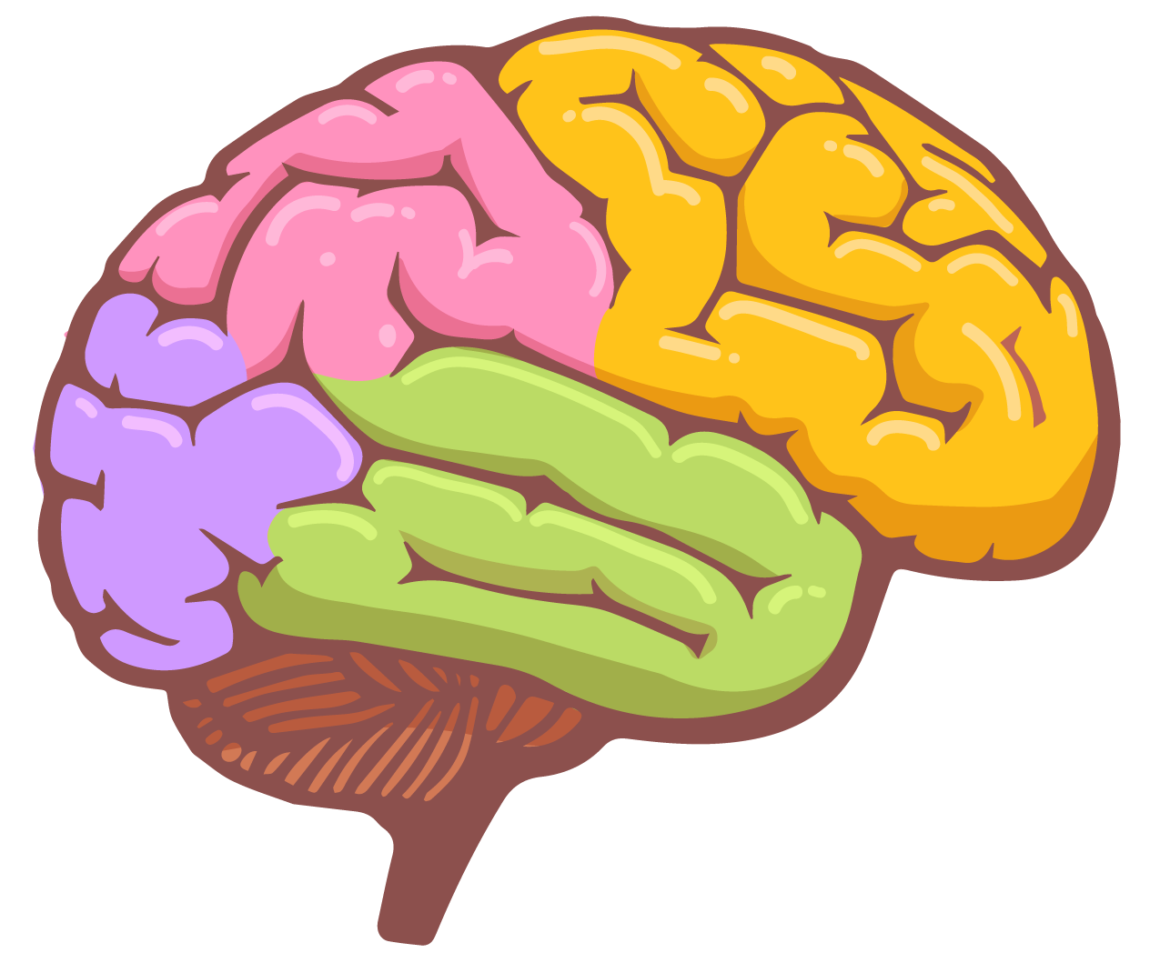
Brains Develop Back to Front
These parts are shouting but…
You may have noticed some of these effects:
Difficulty holding back or controlling emotions
A preference for physical activity
A preference for high-excitement and low-effort activities (video games, sex, drugs, rock ‘n’ roll)
Poor planning and judgement; rarely thinking of negative consequences
More risky, impulsive behaviors – including experimenting with drugs and alcohol
Judgement
This part isn’t quite ready to referee
Motivation!
Physical Coordination!
Emotion!

Slide 46
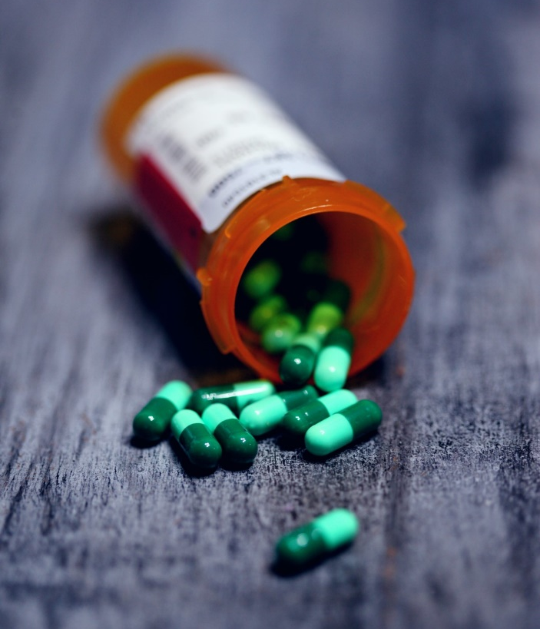
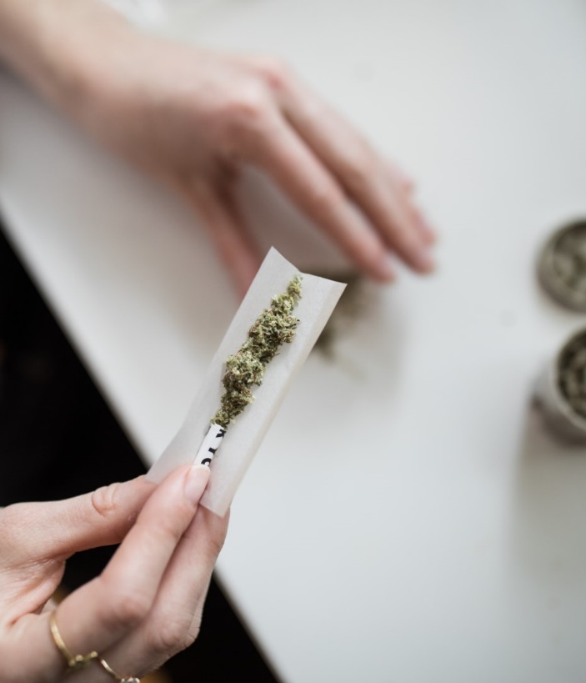
Pre-Screen Questions: High School
How many times in the past year did you…
Drink any alcohol?
Smoke any marijuana?
Use anything else to get high?
(“Anything else” includes illegal drugs, over the counter and prescription drugs, and things that you sniff or “huff”.)
If all answers are “No”, ask CAR question; then stop
Source: http://www.ceasar-boston.org/clinicians/crafft.php

Slide 47
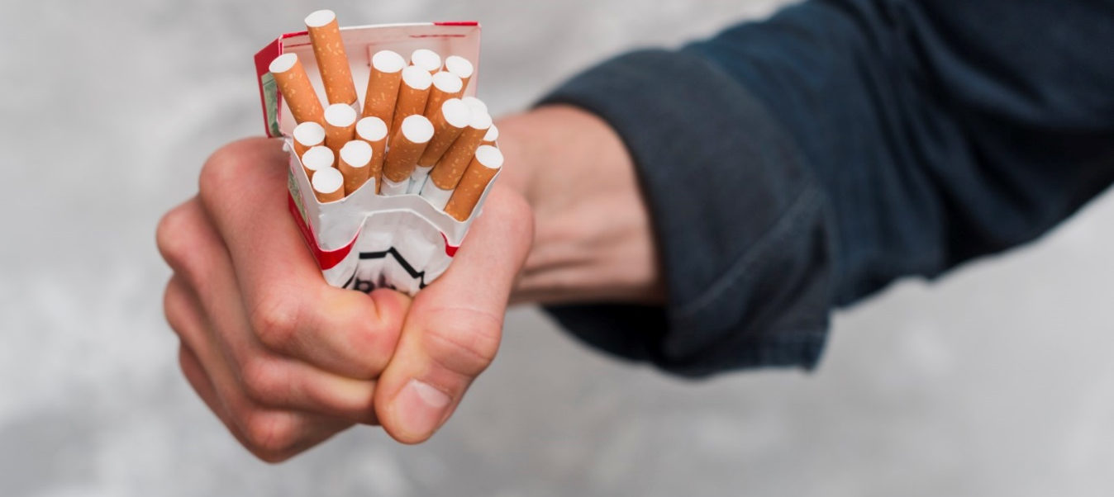
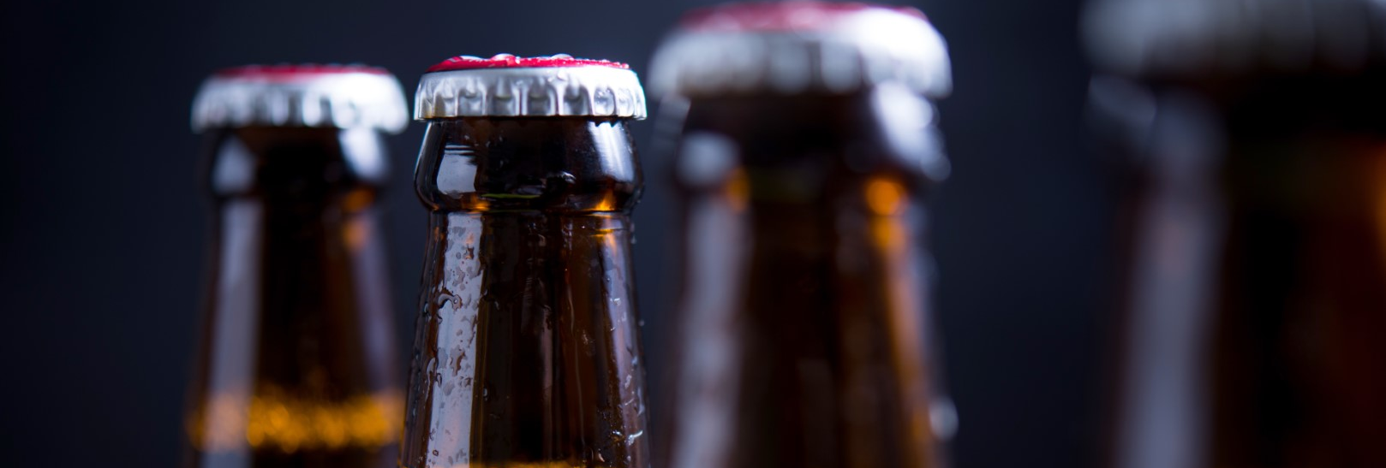
Pre-Screen Questions: Middle School
Do you have any friends who drank beer, wine or any drink containing alcohol in the past year?
How about you ? – in the past year how many days have you had more than a few sips of beer, wine or any drink containing alcohol in the past year?
What about other substances? Do you have any friends who use tobacco, marijuana, inhalants, prescription drugs that were not prescribed to them or anything else to get high?
How about you ? – in the past year how many days have you used tobacco, marijuana, inhalants, prescription drugs that were not prescribed to them or anything else to get high?

Slide 48
CRAFFT
During the PAST 12 MONTHS -
Have you ever ridden in a CAR driven by someone (including yourself) who was “high” or had been using alcohol or drugs? No Yes
Do you ever use alcohol or drugs to RELAX, feel better about yourself, or fit in? No Yes
Do you ever use alcohol or drugs while you are by yourself, or ALONE? No Yes
Do you ever FORGET things you did while using alcohol or drugs? No Yes
Do your FAMILY or FRIENDS ever tell you that you should cut down on your drinking or drug use? No Yes
Have you ever gotten into TROUBLE while you were using alcohol or drugs? No Yes

Slide 49
CRAFFT Scoring
Each “yes” = 1 point
A total score of 2+ is a positive screen and indicates a need for additional assessment (brief intervention)
Source: http://www.ceasar-boston.org/clinicians/crafft.php

Slide 50
Motivational Interviewing (MI): A Review
A collaborative conversation style for strengthening a person’s own motivation and commitment for change.
Source: Miller & Rollnick, 2013

Slide 51
Motivational Interviewing (MI): A Review
Patient-centered
Goal-directed (behavior change)
Helps to resolve ambivalence
A-C-E
Affirms patient’s autonomy
Collaboration between patient and provider
Evokes patient’s own motivation and reasons for change

Slide 52
Giving Feedback & Advice: The MI Sandwich
Ask Permission
“Is it OK if I share with you what is considered high risk drinking according to research studies?”
Give Information or Feedback
Ask for Response
“What do you make of that?”

Slide 53
The Spirit of Motivational Interviewing
Evocation
Change is within the client – to be discovered
Focus on strengths and resources rather than deficits
Evoke and strengthen the person’s own reasons for change

Slide 54
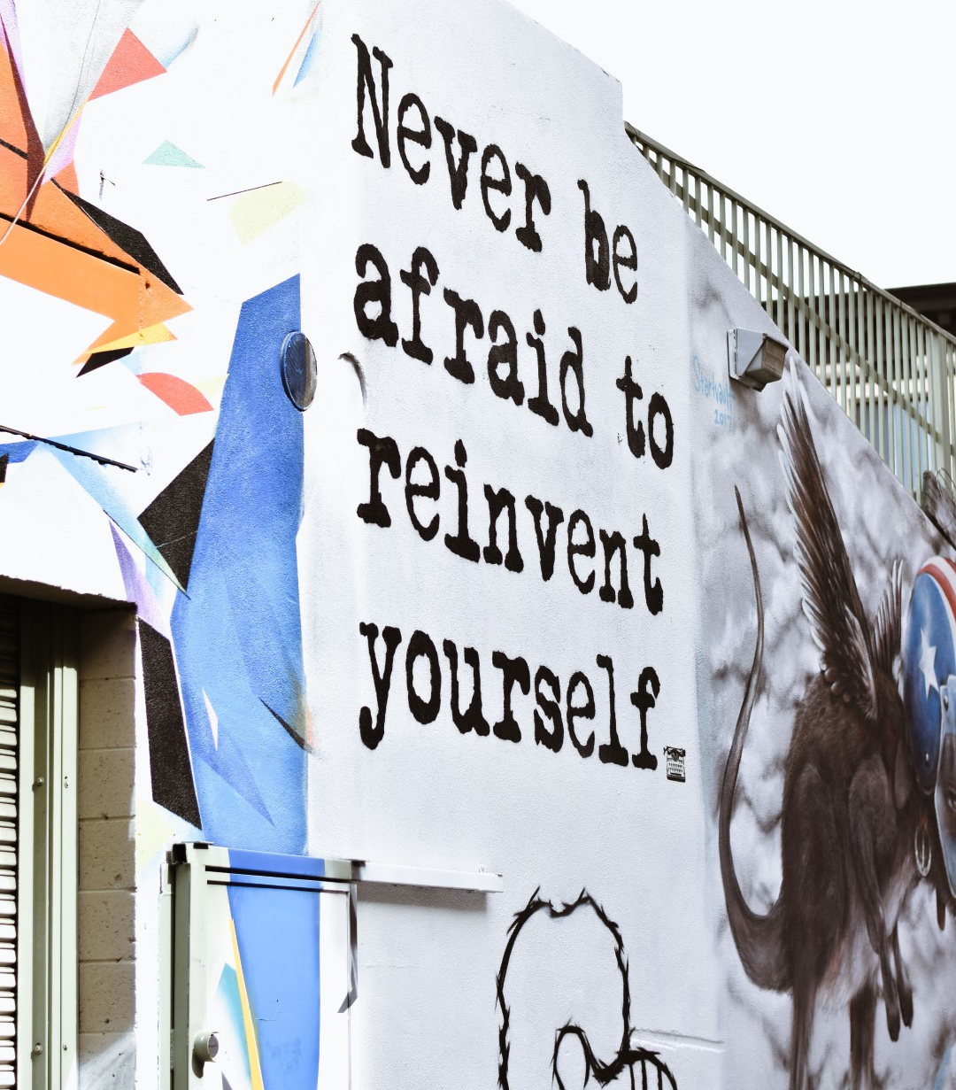
The Spirit of Motivational Interviewing
Partnership / Collaboration
Not DONE TO a passive recipient –MI is done FOR or WITH a person
Recognize the person is the expert
Specific methods or techniques are not prescribed
Let go of the assumption that the clinician is the expert with the solution –avoid the expert trap

Slide 55
The Spirit of Motivational Interviewing
Acceptance / Autonomy
Not to be confused with approval or disapproval
Accepting the worth of individuals as they are
Therapist assuming responsibility increases chances of tug-of-war
Honoring the person’s autonomy
Affirming the person’s strengths and efforts

Slide 56
Key MI Communication Skills:
Open Questions
Affirmations
Reflections
Summaries
O.A.R.S.

Slide 57
Key MI Communication Skills:
O.A.R.S. – Open Questions
Elicit a range of responses beyond yes/no
Prompt patients to think, reflect, and share feelings/opinions
Encourage patient autonomy
“Do you want to stop drinking?”
“What are your thoughts about your drinking?”

Slide 58
Key MI Communication Skills:
O.A.R.S. – Affirmations
Statement and gestures that recognize strengths and acknowledge behaviors that lead to positive change
Must be specific and genuine
“It’s great that you are watching how much you’ve been drinking.”
TED Talk: Rita Pierson)
(3:58-5:08)

Slide 59
Key MI Communication Skills:
O.A.R.S. – Reflection
Statements, not questions
Express empathy
Elicit change talk
Two levels:
Simple: Repeat/Rephrase
Complex: Paraphrase
Patient: “I’ve tried to cut back on my own before, but nothing is going to work for me. I just can’t stop drinking.”
Provider: “You’ve tried to quit drinking in the past and it hasn’t worked. You’re wondering if it’ll be different this time.”
Video: It’s Not About The Nail
Everybody Loves R…Parent Effectiveness

Slide 60
Reflective Listening
SIMPLE REFLECTIONS
COMPLEX REFLECTIONS
Exercise: Hypothesis Testing
Miller & Rollnick, 2013.
Notes:
It’s helpful to think of an iceberg when differentiating between simple and complex reflections. A simple reflection is limited to what shows just above the water or the content that has actually been expressed. A complex reflection makes a guess about what lies beneath the surface.

Slide 61
Key MI Communication Skills:
O.A.R.S. – Summaries
Transition or ending statements
Longer reflection; overview of what patient has shared during conversation
Present patient’s own reasons for change
“Here is what I’ve heard so far…What did I miss?”
“We’ve gone over quite a bit. Let me make sure I am understanding you…”

Slide 62
Change Talk
Statements about change
Linked to a specific behavior
Typically comes from patient
Phrased in the present tense
Desire
Reasons
Need
Commitment
Steps
Ability
I want to…
I could or might be able to…
Things would be better if I …
I really should…
I am ready to…
This week I started…
Source: Rosengren, 2009.

Slide 63
Brief Negotiated Interview (BNI)
Five Steps:
Build Rapport/Engagement
Pros and Cons
Feedback
Readiness Ruler
Action Plan
Developed by BNI-ART Institute,@ BU.edu and The Yale Brief Negotiated Interview Manual. D’Onofrio, et al. New Haven CT: Yale Univ. School of Med. 2005

Slide 64
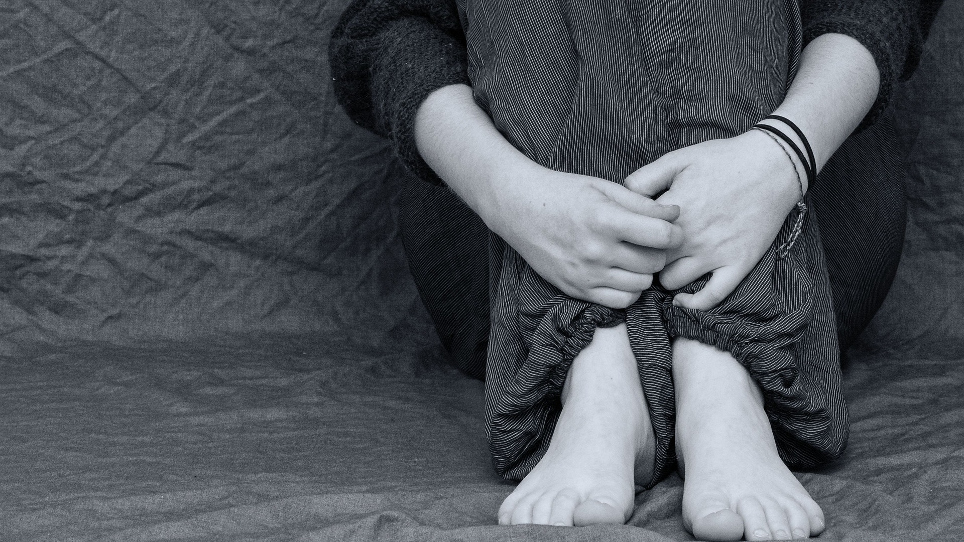
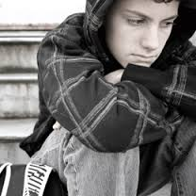
Brief Negotiated Interview
An evidence-based algorithm that provides a structured format for using motivational interviewing skills in the context of clinical care
Open Question?
Ruler?
Action Plan?
Affirmation?
Reflection?
Summary?
Pros/Cons?
Minimize
Push Back?
Feedback?
?

Slide 65
Things to Note about the BNI
Follows a scripted approach
BNI is the skeleton, but you bring it to life!
Not always linear; might need to adapt process as situation unfolds
While ideal, it might not be possible to complete each step at every encounter

Slide 66
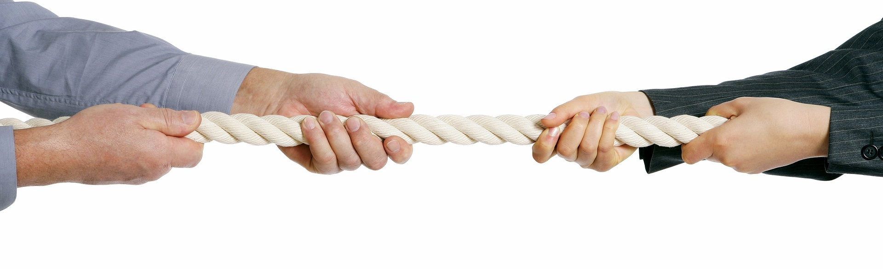
What is Pushback?
Absence of collaboration between two people
Normal part of adolescence and change process
Product of interpersonal dynamics
Cue to try something different (reflections)
Less resistance → more likely to change
GOAL: Not to eliminate pushback, but to minimize it.

Slide 67
Tips to Decrease Patient Pushback
Don’t try to convince them that they have a problem.
Don’t argue about the benefits of change.
Don’t tell them how they should change.
Don’t warn them of the consequences of not changing.

Slide 68
Brief Negotiated Interview (BNI)
Patient Voice and Choice
Guiding, not directing
Avoid the “righting reflex”
Patient as decision maker
They’re in the driver’s seat

Slide 69
Build Rapport/ Engagement
Step 1:
Before we start, I’d like to know more about you. Would you mind telling me a little bit about yourself?
What is a typical day like for you?
How does your [x] use fit in?

Slide 70
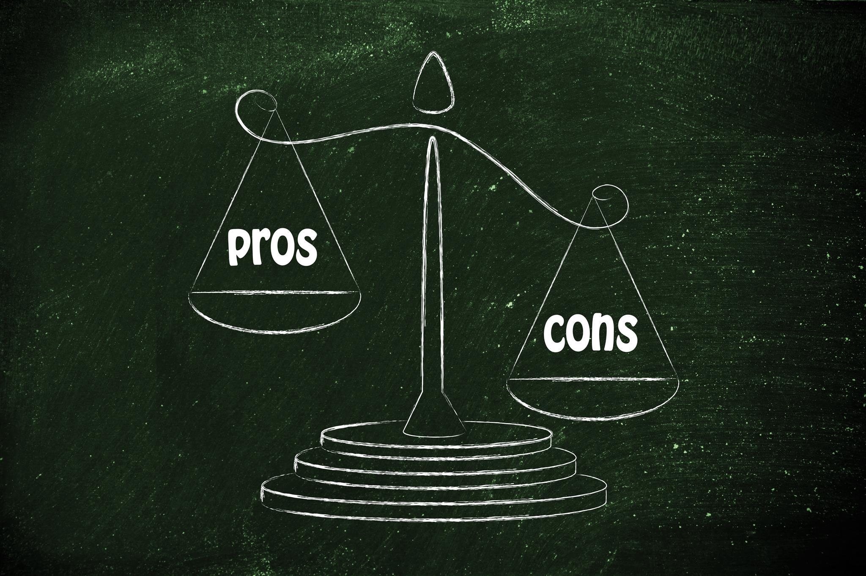
Step 2:
Pros and Cons
I’d like to understand more about your [X] use.
What do you enjoy about [X]? What else?
What do you enjoy less or regret about your [X] use? What else?
If NO cons: Explore problems mentioned in screening.
“You mentioned … Can you tell me more about that situation?”
So, on the one hand you said [PROS], and on the other hand you said [CONS].
Explore PROS and CONS
Use reflective listening
Summarize

Slide 71
Step 3:
Feedback
Ask permission
Provide information
Elicit response
What do you know about the health effects and/or risks of [X]?
Would you mind if I shared some additional information with you?
Provide 1-2 salient substance specific health effects/risks.
What are your thoughts on that?

Slide 72
Step 4:
Readiness Ruler
Readiness ruler
Envisioning change
1 2 3 4 5 6 7 8 9 10
To help me understand how you feel about making a change in your [X] use, [show readiness ruler]…
On a scale of 1-10, how ready are you to change any aspect related to your [X] use?
Why did you choose a [X] and not a lower number like a 1 or 2?
If they choose “0”: What would need to happen in your life to consider making a change?

Slide 73
Step 5:
Action Plan
What are you willing to do for now to be safe and healthy?...What else?
On a scale of 1-10, how confident (1-10) are you that you could do that?
Why did you choose a [X] and not a lower number like a 1 or 2?
What are some challenges to reaching your goal?
Let me summarize what we’ve been discussing, and you let me know if there’s anything you want to add…[review action plan]
Thanks for being so open with me today!
Develop plan
Assess confidence
Explore challenges
Summarize
Thank client

Slide 74
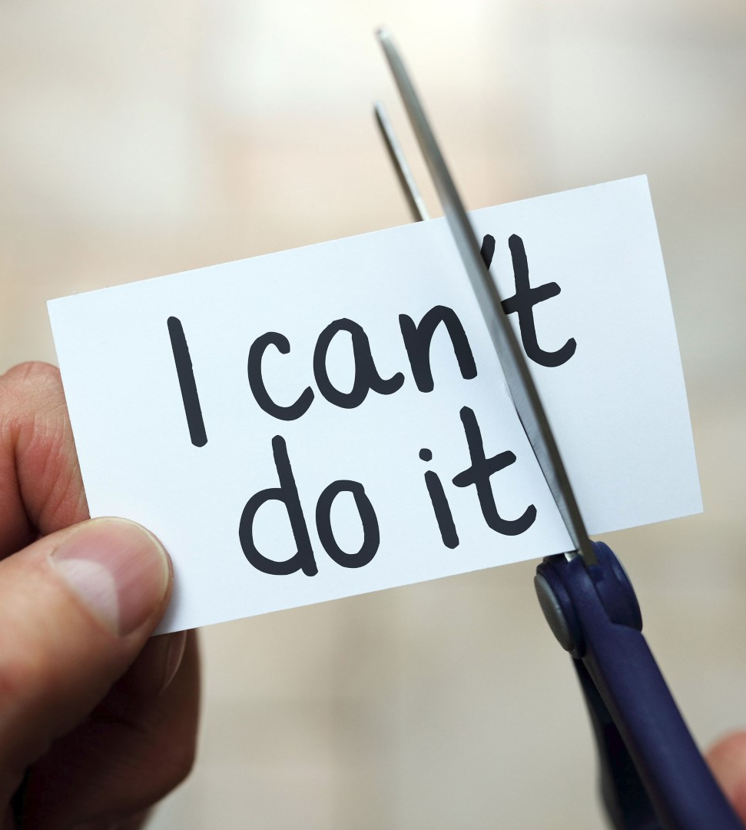
Confidence Scale
Assesses client’s confidence
Identifies potential barriers
“What would you need to change for you to feel more confident?”
Can discuss previous successes to build confidence
“What changes have you made in your life?”
“How did you accomplish that change?”

Slide 75
The Key to SBIRT: Brief Intervention
Brief
Non-confrontational
Directive & collaborative conversation
Uses Motivational Interviewing (MI) principles & strategies to enhance motivation to change use of alcohol (and other drugs)
Video: BNI-ART ER effective MD
Notes:
Developed for use in primary care to increase a pt’s motivation for change. Can be used by any staff member of the practice but is particularly impactful when delivered by the pcp
Motivational Interviewing the heart, an evidence based counseling style that when used, patients with risky drinking will decrease the quantity of their drinking. By relying on MI, a good brief intervention incorporates both the spirit of MI, such as being non-confrontational, being collaborative , sees the pt as the expert on his/her life as well as certain MI techniques such as the importance and confidence rulers, ie asking pts on a 1-10 scale how important is is for them to make a change and how confident they in being able to make the change. So this is a dialogue; not a lecture.

Slide 76
Brief Intervention: Education & Information; Lower Risk
Giving Feedback & Advice
Determine the patient’s perception of his/her need to change and perceived ability to change
“How do you see your drug use?”
Gauge the patient’s reaction to the information
“What do you think about this information?”
Assess the patient’s stage of readiness to change behavior
“On a scale from 0 to 10, how important is it for you to change?… Why not a lower number?”
Samet, JH, Arch Intern Med 1996

Slide 77
SBIRT BNI Steps
Ask single item question
Assessment if needed (AUDIT, CAGE, etc…)
Ask for permission to provide information
Reflect on their reaction to the information you provide them
Use positive affirmation
Ask if they are ready to make a change
If so gauge with Readiness Ruler.
Once answer is given ask
“Why not (lower number)….?”
Reflect on their response
Summarize the interview
“Do you have any other questions?”
“Did I miss anything?”
Make referral if necessary

Slide 78
RI SBIRT: Primary Care Simulation Video
https://www.youtube.com/watch?v=7FX8z2cl-nk

