Slide 1
Rhode Island State Innovation Model (SIM)
Leveraging Innovation to Transform Health Systems and Improve Population Health
Vendor Review Presentation
SBIRT Training and Resource Center
(Screening, Brief Intervention, and Referral to Treatment)
Rhode Island College

Slide 2
Project Leads: Chris Dorval Jayashree Nimmagadda SIM Liaison: James Rajotte, RIDOH Catherine Hunter, BHDDH Project Start Date: 7/01/2016 Months Implementing: 27 Months Total Budget: $486,083 Formally Evaluated: Yes-URI SBIRT
Basic Info
Notes:
Aligned the words on this slide

Slide 3
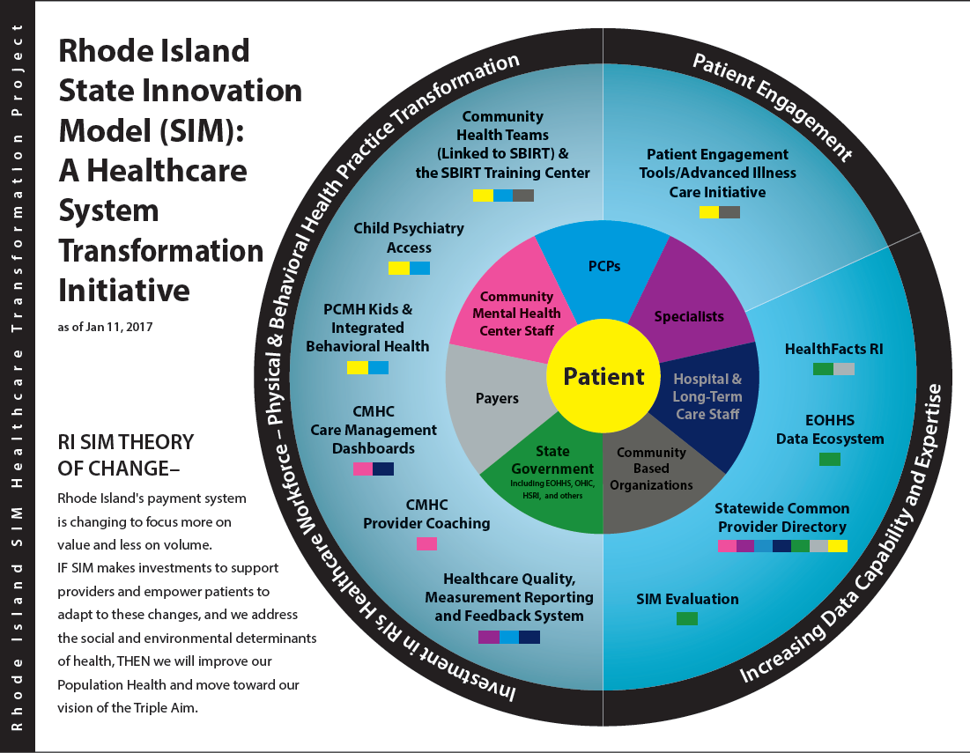
SIM Transformation Wheel

Slide 4
Background on Project Selection
Rhode Island is above national average of drug and alcohol use, and above 80% of those people are not getting treatment.
See Appendix 1
Unmet Need
Provides training, resources, and fidelity for healthcare professionals (HCPs) to begin substance use screening and connecting people with treatment in various settings.
See Appendix 2
How It Works
Notes:
Made bigger and spelled out healthcare professionals and RI.

Slide 5
Project Goals and Audience
Goal 1: Develop training content, curriculum, and mixed-method training plan to improve clinician competency and confidence
Goal 2: Develop standards for certification: trainers/professionals
Goal 3: Train 240 HCPs per year (720 over 3 years)
Goal 4: Develop website for resources and coordination materials to support SBIRT integration efforts (e.g., We Ask Everyone)
Goal 5: Assist with integrating SBIRT into new practice settings: Emergency Departments, Health Centers, Community Health Teams, Dental Providers, Community-based Programs, etc.
Target Audience(s):
Healthcare professionals (HCPs) of all types, including healthcare students who will be entering the workforce.
Notes:
Changed target audiences; Altered goal four and five.

Slide 6
Evidence Base and Related Studies
Findings from similar projects:
SBIRT is the dominant strategy to alert health care practitioners to excessive alcohol and drug use and the possible need for a structured intervention.
The U.S. Preventive Services Task Force (USPSTF) recommends routine screening for alcohol use disorders in primary care; the initial recommendation was released in 2004 (Whitlock et al, 2004) and updated and reiterated in 2013 (Moyer, 2013).
The value of screening for drug use disorders was less apparent and the USPSTF found insufficient evidence to support a recommendation for routine screening for illicit drug use among adolescents, adults and pregnant women (Polen, et al., 2008).
Evidence base used for project design:
Centers for Disease Control and Prevention. Planning and Implementing Screening and Brief Intervention for Risky Alcohol Use: A Step-by-Step Guide for Primary Care Practices. Atlanta, Georgia: Centers for Disease Control and Prevention, National Center on Birth Defects and Developmental Disabilities, 2014.
Notes:
Changed per call

Slide 7
Program Operations: CHTs/SBIRT Sites
Identify SIM CHTs and SBIRT Sites in need of training.
Coordinate training and logistical needs. Tailor training to specific agency needs.
Modules 3-9
Provide direct training and observed simulation.
Modules 1 & 2*
Collect data to evaluate effectiveness of clinician competencies.
Provide ongoing training, support, feedback and materials.
Modules 3-9*
Collect data to evaluate effectiveness of clinician competencies.
* Modules2-9 are part of the required curriculum for SBIRT sites. Modules 2 &3 have been offered to outside partners and are part of Train the Trainer Plan.

Slide 8
Results to Date
In over two years we have trained 937 healthcare professionals* in SBIRT, and we are currently on pace to eclipse over 1,000 healthcare professionals by the end of SIM funding.
* as of 10/1/18
Notes:
Changed title and add projection for remainder of grant

Slide 9
Results to Date (Continued)
Integrating Into New Areas
Trained over 60 Dentists, Dental Assistants, and Dental Hygienists as part of a Dental Mini-Residency
Trained entire nursing department at Women and Infant’s Hospital
Trained entire social work department across Lifespan hospitals
Lectured on SBIRT into grand rounds 2x for Lifespan physicians and nurses (1 adult and 1 adolescent)
Integrated SBIRT into Community Health Worker (CHW) certification curriculum at RIC
Provided training for Peer Recovery Specialists, RIC CO-EXIST, transitional housing programs
Year One 2*
Year Two 19
Year Three 2**
Notes:
Spelled out social work
Changed IEH to at RIC
Spelled out W and I

Slide 10
Question
Do you see any partnership opportunities or other unique agencies to partner with us that we haven’t considered?
Notes:
Changed question – keep if you like it.

Slide 11
Results to Date (Continued)
Certified Trainers
Trainer Goal
3 Year Goal: 18
Year One: 1
Year Two: 3
Year Three: 3*
*6 in progress

Slide 12
Evaluation of SBIRT Training
Significant changes in attitudes
Stronger agreement that involvement with a patient can make a difference in his/her substance use
Stronger disagreement that patients would be angry if asked questions about their substance use
Significant increase in knowledge
For both general SBIRT knowledge (e.g., standard drink size, risky drinking levels) and motivational interviewing skills
Significant increase in confidence to perform all aspects of SBIRT
Notes:
Add p-values

Slide 13
Evaluation of SBIRT Training
Notes:
Added title and made bigger

Slide 14
Qualitative Anecdotes
Pediatricians became interested! So we partnered with RI AAP/CTC for the Adolescent SBIRT Learning Collaborative and RIC secured/incorporated online simulations through Kognito for adolescent and adult SBIRT.
Providers needed aids to feel comfortable asking questions about substance use! So we launched Rhode Island’s We Ask Everyone Campaign, providing posters and lapel pins for providers to have on-site to increase comfort with asking these questions and telling patients that we ask everyone.
“These We Ask Everyone materials would be great to help facilitate end-of-life discussions.” - Health Equity Summit Attendee
“Wearing this (pin) has opened up doors to ask questions about gender and sexual identity.” - Rhode Island Provider
Patients needed to be aware of changes (e.g., substance use screening) in their medical care! So we developed and promoted Rhode Island’s Because We Care media campaign, using billboards and bus stops for to raise awareness.
“I saw your billboard on my way out of my favorite coffee shop and wanted to find out more about this.” - Philanthropy Director
SBIRT has implications for the workplace!
Partnering on the Governor’s Recovery Friendly Workplace Initiative to ensure key messages and resources from the SBIRT Training and Resource Center are included.
Notes:
Changed Header and Slide

Slide 15
Lessons Learned
New Unmet or Changing Needs
Referral resources for SUDs in Rhode Island are still not adequate to meet needs.
Systems for treatment are disconnected and difficult to navigate.
Normalizing questions remains challenging.
Things to Do Differently
Improve notification processes for sites/partners who need new hires trained in order to adequately prepare training calendar.
Be more proactive with Community Health Team and SBIRT Site training protocol as a subset of the Training Plan.
What Would Be Helpful Post-SIM
Expand training to other behavioral health integration topics, especially related to SUD.
Build relationships with SUD treatment providers.
Study changes in patient/provider comfort with SUD-related questions.
Notes:
Added to column one – last bullet
Second column – revised wording and order of these – make sure you check – tried to make it more generic
Third column – altered last bullet for formatting
Campaign to normalize conversations about substance use in practices and the community, including the and we are currently expanding this campaign to address other SDOH’s.

Slide 16
Sustainability Approaches
Funding
Initial sustainability secured through State Opioid Response (SOR) Grant.
Awaiting additional funding decision from CVS for support in early 2019.
Partnerships
Working with additional partners to integrate SBIRT within other projects (e.g., CTC-RI, RI AAP, SUMHLC, United Way, and the Governor’s Office).
Learning
Focusing development of certified SBIRT trainers who can train and ensure SBIRT model fidelity within their agencies.
Expanding We Ask Everyone Campaign to include questions on: EOL, SDOH, etc.
Evaluation
Evaluate curriculum implementation and utilization of online/in-person SBIRT modules with URI.
Exploring options to meet opioid-related continuing education credits.
Notes:
Bulleted and made changes as we suggested
Edited eval bullets to format – please check.

Slide 17
Main Takeaways
Spending SIM grant dollars wisely and secured initial sustainability through State Opioid Response grant.
Exceeding goal for number of HCPs trained. Additional resources (e.g., We Ask Everyone materials) well received. Significant improvements in provider attitudes and confidence.
Training SBIRT Train-the-Trainers to ensure continuity of
SBIRT (and fidelity) in many SIM/SBIRT partner sites in Rhode Island. Students trained in SBIRT prior to entering workforce.
Notes:
See changes here. More readable and big takeaways.

Slide 18
Contact Information
Chris Dorval
cdonovandorval@ric.edu
401-626-0169
Project Websites:
www.risbirt.org

Slide 19
Final Question
Who has an organizational need for SBIRT training and who wants to help us further disseminate the We Ask Everyone message? Any takers?
Notes:
Keep this if you like it.

Slide 20
QUESTIONS?

Slide 21
Background on Project Selection Appendix 1
Unmet Need
Rhode Island ranks above the national average on Illicit Drug Dependence 3.4% compared to 2.6% (SAMSHA, 2015)
In RI 82.7% Illicit Drug Use Disorders did not receive treatment for illicit drug use (SAMSHA, 2015).
Rhode Island ranks above the national average on Alcohol Abuse or Dependence (7.7% compared to 6.5% (SAMSHA, 2015)
Rhode Island ranked 3rd in the nation in deaths related to Alcohol poisoning at 22.8 deaths per million people (Centers for Disease Control and Prevention, 2015)
In RI 92.6% People indicated with Alcohol Use Disorders were not able to connect to treatment (SAMSHA, 2015).

Slide 22
SBIRT Sites Training Curriculum Appendix 2
Total Training Hours: 19
Curriculum was designed to be implemented over an 18 month period.

